Slide 1
Computational Analysis of Religious and Ideological Linguistic Behavior
Seth Green, Megan Stiles, Leigh Harton, Samantha Garofalo
Advisor: Don Brown
Client: UVa Initiative on Religion, Politics, and Conflict (RPC)
Sponsor: Army Research Lab (ARL)
Notes:
Sam

Slide 2
Collaborators
Don Brown, Data Science Institute
Peter Ochs, Jonathan Teubner, Essam Fahim, and Syed Moulvi, RPC
Mohamed Al Boni, UVa Systems Engineering
Notes:
Sam

Slide 3
Motivation
Notes:
Sam

Slide 4
Problem: How to work with Value-Based Groups?
What is a Value-Based Group?
Any group motivated by a set of values
Religious or non-religious
Who needs to work with Value-Based groups?
US Government
Humanitarian Groups
Business Leaders
Large-Scale Goals:
Real-time recommendations to organizations on the ground
Motivation Technical Approach Results Conclusion
Notes:
Sam

Slide 5
Linguistic Rigidity
1-9 Scale
Number of definitions not the definition itself is what matters
Use Manual Method as Ground Truth
1 2 3 4 5 6 7 8 9
Holy
Holy
Self-Sacrifice
Compassion
Wisdom
Trustworthiness
Motivation Technical Approach Results Conclusion
Notes:
Sam

Slide 6
Related Work
Venuti et al. (2016)
Text Categorization and Topic Detection
Gupta et al. (2009)
Gabrilovich et al. (2013)
labeling text documents using outside corpora
Random Forest
Palomino-Garibay et al. (2015)
Treeratpituk et al. (2009)
Support Vector Machines (SVM)
Joachims (1998)
Motivation Technical Approach Results Conclusion
Notes:
Sam

Slide 7
About Our Data
Group | # Documents | Group Rank
ACLU | 40 | 3
American Ethical Union | 15 | 8
Bahai | 73 | 6
Dorothy Day | 774 | 4
Integral Yoga/Yogaville | 59 | 6
ISIS | 48 | 1
John Piper | 579 | 4
Liberal Judaism | 166 | 6
Malcolm X | 15 | 2
Meher Baba | 265 | 8
Pastor Anderson | 228 | 1
Rabbinic | 58 | 4
Sea Shepherds | 606 | 2
Steve Shepherd | 728 | 4
Unitarian | 301 | 7
Westboro Baptist Church | 422 | 1
Input
Raw ideological text
Output
Number on Linguistic Rigidity Scale
Sources:
Venuti et al. (2016) corpus
New Groups
Web Scraping
OCR for PDFs
Motivation Technical Approach Results Conclusion
Notes:
Sam

Slide 8
Technical Approach
Context Vectors
Keyword Selection
Judgement Classification
Pronoun Analysis
Notes:
Seth

Slide 9
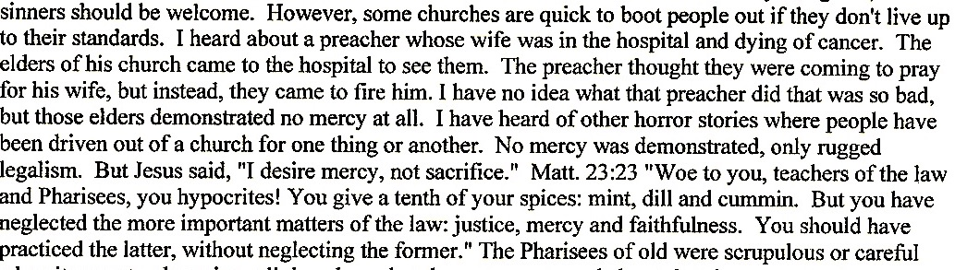
Context Vectors
Raw Text
Motivation Technical Approach Results Conclusion
Notes:
Seth

Slide 10
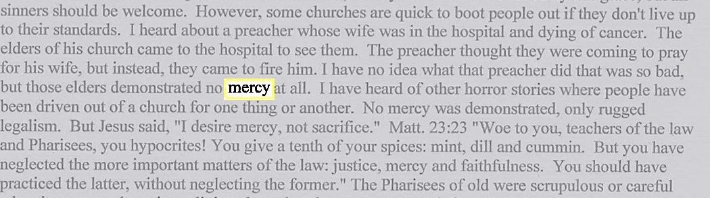
Context Vectors
Identify Keywords
Motivation Technical Approach Results Conclusion
Notes:
Seth

Slide 11
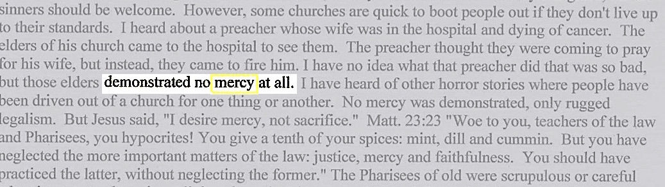
Context Vectors
Collect words in context vector
Motivation Technical Approach Results Conclusion
Notes:
Seth

Slide 12
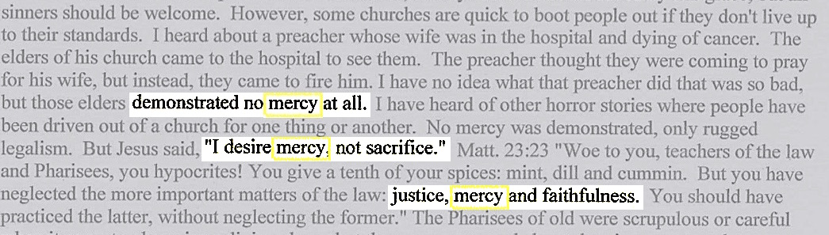
Context Vectors
Repeat for all occurrences of keyword
Singular Value Decomposition to vector of length 100
Calculate Average Semantic Density and Distributional Co-occurrence Score
Motivation Technical Approach Results Conclusion
Notes:
Seth

Slide 13
TFIDF Matrix
Term | Freq
servanthood | 4
selfexalt | 2
coquett | 1
dumbfound | 1
sabbath | 11
manger | 1
unti | 1
childlik | 2
personhood | 1
jesus | 31
IDF
1,443
1,443
1,443
690
47
378
353
169
305
10
TFIDF
5,773
2,887
1,443
690
515
378
353
338
305
302
Motivation Technical Approach Results Conclusion
Notes:
Seth

Slide 14
Value Words
TFIDF Method w/Pronouns
TFIDF Method w/out Pronouns
Venuti et al. (2016) Method
Motivation Technical Approach Results Conclusion
Notes:
Seth

Slide 15
Judgment Classification
Venuti et al. (2016) Method:
Judgment = (noun + “to be” verb + adj/adv)
New Method:
Judgment = pronoun + keyword
Motivation Technical Approach Results Conclusion
Notes:
Megan

Slide 16
Judgment Classification
Noun + ”to be” Verb + Adj/Adv
Venuti et al. (2016)
Pronoun + Keyword
% of Judgment
% of Judgment
Linguistic Rigidity
Linguistic Rigidity
Motivation Technical Approach Results Conclusion
Notes:
Megan

Slide 17
Pronoun Analysis
“They” Pronouns
“We” Pronouns
Fraction of Words that are “They” Pronouns
Fraction of Words that are “We” Pronouns
Linguistic Rigidity
Linguistic Rigidity
Motivation Technical Approach Results Conclusion
Notes:
Megan

Slide 18
Results
Binned Document Analysis
Single Document Analysis
Notes:
Seth
outline

Slide 19

Binned Document Analysis
Why Binned Documents?
Understand a group’s baseline score
Comparison to previous work
# of Documents
4,568
5
Motivation Technical Approach Results Conclusion
Notes:
Megan
Note: total # of documents = all text because we have a group score

Slide 20
Results – Group Scores
Model Accuracy
97%
Venuti et al. (2016) baseline
Accuracy
Run ID Number
Motivation Technical Approach Results Conclusion
Notes:
Megan

Slide 21
Results – Group Scores
Compared to Venuti et al. (2016)
Using Extended Data Set
Model | Accuracy | Venuti et al. (2016)
Random Forest | 96.5 | 86.0
SVM | 97.2 | 84.0
Boosted Tree | 96.2 | N/A
Artificial Neural Net | N/A | 80.0
Average | 96.6 | 83.3
Model | Accuracy | Mean Absolute Error
Random Forest | 96.1 | 0.239
SVM | 96.3 | 0.222
Boosted Tree | 95.4 | 0.246
Average | 96.0 | 0.236
Motivation Technical Approach Results Conclusion
Notes:
Megan

Slide 22

Single Document Analysis
Why Single Documents?
Identifying potential spikes or deviations from a groups baseline
Moving towards real-time, on-the-ground analysis
# of Documents
342
3
4
5
Motivation Technical Approach Results Conclusion
Notes:
Leigh
# of Documents = what we have ground truth on for single docs

Slide 23
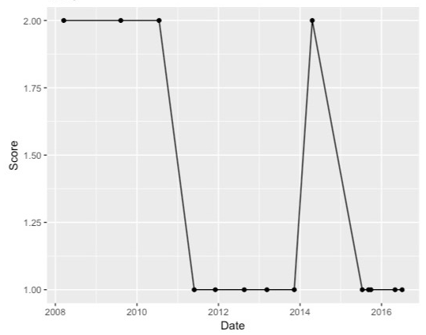
Westboro Baptist Church
Linguistic Rigidity Score
Signals
Snyder vs. Phelps
Judgment Fraction
Snyder vs. Phelps
Unique Word Count
Document Date
Document Date
Document Date
Motivation Technical Approach Results Conclusion
Notes:
Leigh
Snyder vs. Phelps - Westboro Baptist Church wins Supreme Court case for right to protest military funerals March 2, 2011
update in illustrator

Slide 24
Word Embeddings
What are Word Embeddings?
Vocabulary mapped to vectors
Westboro Baptist Church
John Piper
Motivation Technical Approach Results Conclusion
Notes:
Leigh

Slide 25
Results – Single Document Scores
Model | Accuracy | Mean Absolute Error
Random Forest | 77.5 | 0.805
SVM | 70.5 | 1.095
Boosted Tree | 69.7 | 1.084
CNN with Embeddings | 65.6 | 1.125
Motivation Technical Approach Results Conclusion
Notes:
Leigh

Slide 26
Conclusion
Notes:
Seth
outline

Slide 27
Conclusion
In a global society, we want to work with Value-Based groups
How a group uses language provides guidance for how they will interact
Computationally Efficient
250 hours vs 1 hour
Real-time recommendations to organizations on the ground
Understanding both Religious and Ideological groups
Motivation Technical Approach Results Conclusion
Notes:
Leigh

Slide 28
Questions?
Notes:
Leigh

Slide 29
References
Consultation with researchers at the University of Virginia Center for Religion, Politics, and Conflict (RPC). 1540 Jefferson Park Avenue, University of Virginia, Charlottesville, VA 22904-4126.
Venuti, Nicholas, Sachtjen, Brian, McIntyre, Hope, et al. “Predicting the Tolerance Level of Religious Discourse Through Computational Linguistics,” presented at the 2016 IEEE Systems and Information Engineering Design Conference (SIEDS ‘16), Charlottesville, VA, 2016.
Wade-Benzoni, Kimberly A., Hoffman, Andrew J., Thompson, Leigh L., et al. 2002. "Barriers to resolution in ideologically based negotiations: The role of values and institutions." Academy of Management Review 27, pp. 41-57.
Lederach, John Paul and Appleby, Scott R. “Strategic Peacebuilding: An Overview,” in Daniel Philpott and Gerard Powers, Strategies of Peace (Oxford: Oxford University Press, 2010), pp. 19-44.
“Algorithmia.” 2016. http://blog.algorithmia.com/introduction-natural-language-processing-nlp/. Accessed: March 30, 2017.
“Expert System: Natural language processing and text mining.” 2016. http://www.expertsystem.com/natural-language-processing-and-text-mining/. Accessed: March 30, 2017
Gupta, Vishal. and Lehal, Gurpreet S., 2009. “A survey of text mining techniques and applications.” Journal of emerging technologies in web intelligence, 1(1), pp.60-76.
Gabrilovich, Evgeniy and Markovitch, Shaul. January 2007. “Computing semantic relatedness using wikipedia-based explicit semantic analysis.” (In IJcAI Vol. 7), pp. 1606-1611
James, Gareth, Witten, Daniela, Hastie, Trevor, et al. 2013. Introduction to Statistical Learning, pp 303-372.
Palomino-Garibay, Alonso, Camacho-González, Adolfo T., Fierro-Villaneda, Ricardo A., et al. 2015. “A random forest approach for authorship profiling.” Cappellato et al. [8].
Treeratpituk, Pucktada and Giles, C. Lee. June 2009. “Disambiguating authors in academic publications using random forests.” In Proceedings of the 9th ACM/IEEE-CS joint conference on Digital libraries, pp. 39-48.
Joachims, Thorsten, 1998. “Text categorization with support vector machines: Learning with many relevant features.” Machine learning: ECML-98, pp.137-142.
Özgür, Arzucan, Levent Özgür, and Tunga Güngör. "Text categorization with class-based and corpus-based keyword selection." International Symposium on Computer and Information Sciences. Springer Berlin Heidelberg, 2005.
Richardson, Leonard. Beautiful soup documentation, [Online] Available: https://www.crummy.com/software/BeautifulSoup/bs4/doc/.
Bird, Steven, Edward Loper and Ewan Klein (2009), Natural Language Processing with Python. O’Reilly Media Inc. Available: http://nltk.org/book
Pennington, Jeffrey, Richard Socher, Christopher D. Manning. "GloVe: Global Vectors for Word Representation." Proceedings of the 2014 Conference on Empirical Methods in Natural Language Processing. 2014.
Csardi, G. and Nepusz, T. Package ‘igraph’. [Online]. Available: http://igraph.org/python/
Íñigo-Mora, Isabel. "On the use of the personal pronoun we in communities." Journal of Language and Politics. Volume 3, Issue 1, 2004, pages: 27–52.
Maitland, Karen and John Wilson. "Pronominal selection and ideological conflict." Journal of Pragmatics. Volume 11, Issue 4, August 1987, Pages 495-512.
Karatzoglou, Alexandros, Alex Smola, and Kurt Hornik, Package ‘kernlab’.[Online] Available: https://cran.r-project.org/web/packages/kernlab/kernlab.pdf
Liaw, Andy and Matthew Wiener, R Package ‘randomForest’. [Online] Available: https://cran.r-project.org/web/packages/randomForest/randomForest.pdf
Chen, Tianqi, Tong He, Michael Benesty, Vadim Khotilovich, and Yuan Tang, Package ‘xgboost’ [Online] Available: https://CRAN.R-project.org/package=xgboost

